Slide 1
Graphs
Data Structures and Algorithms

Slide 2
Outline
Non-Linear Data Structures
Graphs
Traversal
BFS
DFS
Topological Sort
Shortest Path
Dijkstra’s Algorithm

Slide 3
Graph Traversal
Visiting all vertices one bye one
Just like we did in tree but remember tree has no cycles, so its bit different in graph scenario
We need to keep track of nodes that have been visited/discovered
And if graph is disconnected
We cannot traverse each vertex from just a single vertex
Two ways:
Breadth First Traversal
Visit nodes that are closest to starting node before other nodes
Depth First Traversal
Visit recursively one side before going back to other side

Slide 4
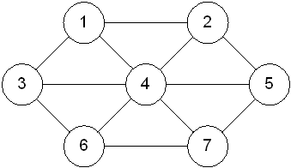
Breadth First Search
Given a graph G and a start vertex, breadth first search systematically explores edges of G to discover vertices that are reachable from start vertex.
It is named as breadth first because as it traverse the vertices at distance K before the vertices at distance k+1, where k represents number of edges.
BFS order of vertices From 1: 1 , 2, 3, 4, 5, 6, 7
Vertices at edge distance of 1are visited before vertices at edge distance of 2.
So, BFS discovers each vertex by exploring minimum possible number of edges.

Slide 5
Breadth First Search
Progress can be tracked by maintaining a state for each vertex. Vertices can be in three distinguished states:
Not discovered
Partially discovered: a vertex is discovered first time but not fully explored.
Finished/Fully explored: vertex that has been fully explored, all its adjacent nodes have been discovered.
Tri-Coloring
Vertices are given colors according to state
White : un discovered
Grey: partially discovered
Black: finish/fully explored
1
2
3
4

Slide 6
Breadth First Search
BFS: from 1
All vertices are undiscovered at start.
Mark start vertex as discovered
Go to its adjacency list→ 1 edge distance
first node is 2 and its un-discovered
2nd node is 3 and it’s undiscovered
1’s adjacency list is fully explored now.
Go to 2’s adjacency list.→ 2 edge distance
Its vertices are already discovered
Go to 3’s adjacency list.→ 2 edge distance
Its vertices are already discovered
Graph is fully explored
1
2
1
2
3
3
∅
2 | 3
1
2
1
2
1
3
3
3
1
2
1
2
3
3
2 | 3
∅

Slide 7
Breadth First Search (BFS)
Algorithm: BFS(G, start)
Input: Graph and start vertex of graph.
Output: list of vertices reachable from start in order of their discovery time
Steps:
Q = new Queue()
For each vertex v in G
color[v]=white
color[start]=grey
Q.enqueue(start)
While Q is not empty
u= Q.dequeue()
print(u)
For each vertex v adjacent to u
if color[v] is white //undiscovered
color[v]=grey //discovered
Q.enqueue(v)
End if
End For
color[u]=black //fully explored or finished
End While

Slide 8
Breadth First Search
BFS: start vertex=1
1
1
2
3
4
∅
1
2 | 3 | 4
1
2
1
2
1
2
3
4
5
3
4
5
3
4
5
6
6
7
3 | 4 | 5
4 | 5 | 6
5 | 6 | 7

Slide 9
Breadth First Search
BFS: start vertex=1
BFS Order: 1 2 3 4 5 6 7
1
2
2
1
2
1
2
1
1
3
4
5
5
3
4
5
3
4
3
4
6
7
6
7
6
7
6 | 7
7
∅

Slide 10
Breadth First Search (Alternate Approach)
Rather than using tri-coloring, just maintain two states.
If a vertex is undiscovered
It will be marked as visited=false
If a vertex is pushed to queue→ it is discovered
Mark it visited = true
If a vertex is popped off→ it is fully explored
No marking
Algorithm: BFS(G, start)
Input: Graph and start vertex of graph.
Output: list of vertices reachable from start
Steps:
Q = new Queue()
For each vertex v in G
visited[v]=false
visited[start]=true
Q.enqueue(start)
While Q is not empty
u= Q.dequeue()
print(u)
For each node v adjacent to u
if !(visited[v])
visited[v]=true
Q.enqueue(v)
End if
End For
End While

Slide 11
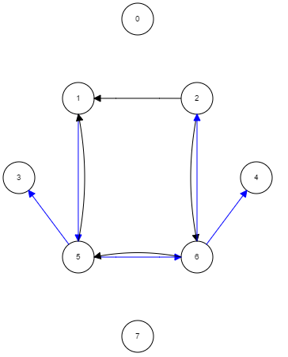
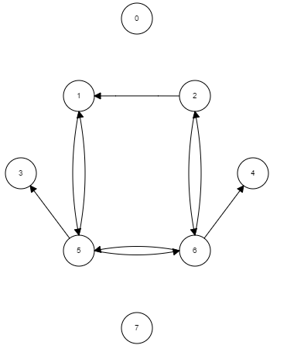
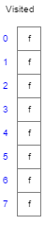
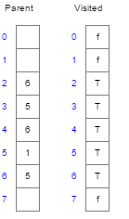
Breadth First Search
Start vertex=1
Order: 1, 5, 3, 6, 2, 4

Slide 12
Breadth First Search
BFS Tree
If graph is connected, by discarding the edges that were not explored during BFS, we can get a BFS tree of graph
Which does not have cycle
2
1
2
3
4
5
3
4
6
7

Slide 13
Breadth First Search
BFS Forest
If graph is not connected, then by traversing each connected component separately a forest of trees can be formed.
a
b
a
b
c
d
g
c
d
g
e
f
e
f
a
b
a
b
c
d
g
c
d
g
e
f
e
f

Slide 14
Depth First Search
From start vertex traverse the vertices at one path in depth till last reachable vertex before traversing other paths. Then go back to last visited node to explore other paths recursively un till all reachable vertices have been traversed.
DFS order of nodes from 1: 1 2 4 3 6 7 5
DFS as it name suggest discover a vertex in depth. When it first discovers a vertex, it will go to its adjacent vertices [adjacency list] and before discovering all its adjacent vertices at once (like BFS does) it will just discover first (undiscovered) vertex, and then will go to this vertex’s adjacent vertices. And process goes one.

Slide 15
Depth First Search
DFS: from 1
Mark start vertex as discovered
Go to its adjacency list, first node is 2 and its un-discovered
Go to adjacency list of 2, 1 is already discovered, discover 3
3’s adjacency list is fully explored now.
We discovered 3 from 2→parent
Go back to 2
Its fully explored now
Repeat process of going back, till start vertex
1
2
3
2
1
1
2
3
3
1
2
1
2
3
3
1
2
1
2
3
3

Slide 16
Depth First Search
Difference from BFS:
3 is discovered from 2 and not 1
Before discovering all adjacent vertices of 1, DFS has went to adjacent vertices of 2
Two different time stamps of visit?
Discovery time: Vertex becomes grey
Explore/Finish time: Vertex becomes black
discovery/finish-time
d=0, p=∅
d=1, p=1
1
2
d=2, p=2
3
1/6
2/5
1
2
3/4
3

Slide 17
Depth First Search
Algorithm: DFS(G, start)
Input: Graph and start vertex of graph.
Output: list of vertices reachable from start with their discovery and finish time labels
Steps:
For each vertex v in G
color[v]=white
DFS_Visit(start)
time=0 //a global timer
DFS_Visit (start)
color[start]=grey //discovered
d[start]=time+1 //discovery time
time=time+1
print(start)
for each node v adjacent to start
if color[v]=white
DFS_Visit (v)
color[start]=black //finished
f[start]=time+1 //finish time
time=time+1

Slide 18
Depth First Search
Discovery/explore time
1/
1/
2/
1/
2/
1
1
2
1
2
3/
4
1/
2/
1/
2/
1/
2/
18
1
2
1
2
1
2
4/
3/
4/
3/
4/
3/
3
4
3
4
3
4
5/
5/
6/
6
6
7

Slide 19
Depth First Search
1/
2/
1/
2/
1/
2/
1
2
1
2
1
2
4/
3/
7/
4/
3/
7/8
4/
3/
7/8
3
4
5
3
4
5
3
4
5
5/
6/
5/
6/
5/
6/9
6
7
6
7
6
7
1/
2/
1/
2/
1/
2/
1
2
1
2
1
2
4/
3/
7/8
4/11
3/
7/8
4/11
3/12
7/8
3
4
5
3
4
5
3
4
5
5/10
6/9
5/10
6/9
5/10
6/9
6
7
6
7
6
7

Slide 20
Depth First Search
DFS Oder: 1 2 4 3 6 7 5
PreOrdering: vertices in order of discovery time
1 2 4 3 6 7 5
PostOrdering: vertices in order of their finish time
5 7 6 3 4 2 1
PreOrdering and Postordering are not reverse of each other.
Check on the graph at right.
1/
2/13
1/14
2/13
1
2
1
2
4/11
3/12
7/8
4/11
3/12
7/8
3
4
5
3
4
5
5/10
6/9
5/10
6/9
6
7
6
7
1
2
3
4

Slide 21
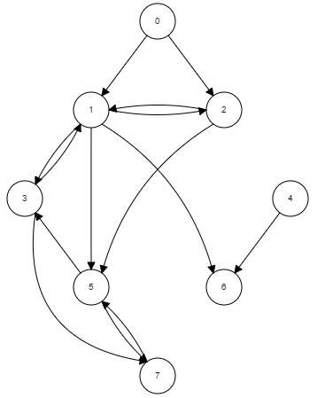
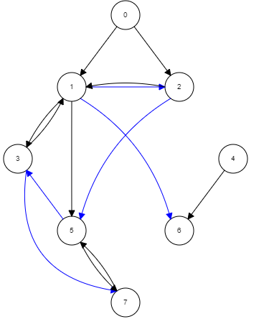
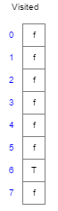
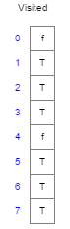
Depth First Search
Start vertex=1
without tri/coloring Order: 1, 2, 5, 3, 7, 6
0
0
1
2
1
2
3
4
3
4
5
6
5
6
7
7

Slide 22
Depth First Search
DFS Tree
If a graph is connected, then by discarding the un-explored edges, resultant set of vertices and edges forms a tree
Multiple trees are possible depending upon choice of start vertex
And how adjacent vertices are picked
1
2
3
4
5
6
7

Slide 23
Depth First Search
DFS Forest
If graph is not connected, then by running DFS on all un-discovered nodes gives a DFS tree forest.
a
b
a
b
c
d
g
c
d
g
e
f
e
f
a
b
a
b
c
d
g
c
d
g
e
f
e
f

Slide 24
Useful Links
A different approach
http://www.personal.kent.edu/~rmuhamma/Algorithms/MyAlgorithms/GraphAlgor/breadthSearch.htm
http://www.personal.kent.edu/~rmuhamma/Algorithms/MyAlgorithms/GraphAlgor/depthSearch.htm
Visualization
https://www.cs.usfca.edu/~galles/visualization/BFS.html
https://www.cs.usfca.edu/~galles/visualization/DFS.html

Slide 25
BFS vs. DFS
Complexity?
Adjacency List?
Adjacency Matrix?
Helps to solve certain problems?
Cycle detection
both
Reachability of vertices
both
Is the graph connected?
both
Shortest path in non-weighted graphs
BFS

Slide 26
Shortest Path
Given a graph, find the shortest path from start node to end node
Applications:
Going from one location to other
Routing phone calls from one network to other network
GPS applications for navigation
And many more
Single source vs. All pair shortest paths
SSSP: single source shortest paths
Shortest path from one vertex to all other vertices
APSP: all pair shortest paths
Shortest path from all vertices to all vertices

Slide 27
BFS-Shortest Path
Non-Weighted Graph:
Let say we want to find shortest paths to each vertex from source vertex?
How BFS can help?
Every edge is considered as having unit weight, means edges are equal in terms of cost.
BFS discovers each vertex by exploring minimum possible number of edges.
That is shortest path
Path length= sum of edges
What information needs to be maintained?
Record distance→ Path Length
Record parent/prev vertex of discovered vertex→ It is the vertex from which you discovered the current vertex.
To track the path from start vertex to destination vertex

Slide 28
BFS-Shortest Path
d=∞, p=∅
d=∞, p=∅
d=0, p=∅
d=∞, p=∅
d=0, p=∅
d=1, p=1
1
1
2
d=∞, p=∅
d=∞, p=∅
d=∞, p=∅
d=∞, p=∅
d=1, p=1
d=1, p=1
3
4
d=∞, p=∅
d=∞, p=∅
d=∞, p=∅
∅
d=∞, p=∅
d=∞, p=∅
1
d=∞, p=∅
d=∞, p=∅
2 | 3 | 4
d=∞, p=∅
d=∞, p=∅
d=0, p=∅
d=1, p=1
d=0, p=∅
d=1, p=1
d=0, p=∅
d=1, p=1
1
2
1
2
1
2
d=1, p=1
d=1, p=1
d=1, p=1
d=1, p=1
d=1, p=1
d=1, p=1
3
4
5
3
4
5
3
4
5
d=2, p=2
d=2, p=2
d=2, p=2
6
6
7
3 | 4 | 5
4 | 5 | 6
5 | 6 | 7
d=∞, p=∅
d=∞, p=∅
d=2, p=3
d=∞, p=∅
d=2, p=3
d=2, p=4

Slide 29
BFS-Shortest Path
d=0, p=∅
d=1, p=1
d=0, p=∅
d=1, p=1
Back track paths from destination to start:
2-1
3-1
4-1
5-2-1
6-3-1
7-4-1
d=0, p=∅
d=1, p=1
1
2
2
1
2
1
2
1
1
d=1, p=1
d=1, p=1
d=1, p=1
d=1, p=1
d=1, p=1
d=1, p=1
3
4
5
5
3
4
5
3
4
3
4
d=2, p=2
d=2, p=2
d=2, p=2
6
7
6
7
6
7
6 | 7
d=2, p=3
d=2, p=4
7
d=2, p=3
d=2, p=4
∅
d=2, p=3
d=2, p=4

Slide 30
Shortest Path(Non-Weighted Graph)
Algorithm: BFS(G, start)
Input: Graph and start vertex of graph.
Output: list of vertices reachable from start along with their paths and distances
Steps:
Q = new Queue()
For each vertex v in G
d[v]=infinity
p[v]=null
End For
d[start]=0
Q.enqueue(start)
While Q is not empty
u= Q.dequeue()
For each node v adjacent to u
if d[v] is infinity //undiscovered
d[v]=d[u]+1
p[v]=u
Q.enqueue(v)
End if
End For
End While

Slide 31
Shortest Path
Weighted Graph?
Shortest path between A to other nodes
B: [A, B]= 2 D: [A, B, D] = 5
C: [A, C]= 3 E: [A, B, E] = 6
How to find?
B
3
D
3
5
A
2
1
6
4
1
C
E
7

Slide 32
Shortest Path
Weighted Graph?
Shortest path between A to other nodes
B: [A, B]= 2 D: [A, B, D] = 6
C: [A, C]= 3 E: [A, B, E] = 7
How to find?
Can we use BFS still?
BFS shortest path from A to B is 3
Actual shortest path from A to B is 2
So simple BFS will not work
But why it works flawlessly with unit weights
B
3
D
3
5
A
2
1
6
4
1
C
E
7

Slide 33
Shortest Path
Modify BFS Shortest Path Algorithm to handle weights
Instead of finalizing distance of a nodes when we simply visit them, we should only finalize node which has minimum distance so far.
The node that is popped out has been finalized but nodes inside queue will continue to get updated when ever we can visit them from popped out node
So, a priority queue is needed instead of queue, to pop out the node with minimum distance so far from start node
See the example:
A is start vertex, it will be pushed to queue with distance 0
Now check adjacent nodes, B and C will be pushed to queue with distance 3 and 1
But now instead of popping out B which comes first order wise, we will pop C
Because it’s distance is 1 from A
Now B is also adjacent node of C, so we will see if its distance can be updated which was 3 when it was discovered from A.
it will become 2 now
Keep on updating distances of adjacent nodes, when a node is popped out.
Untill queue becomes empty
3
B
A
2
1
1
C

Slide 34
Dijkstra’s Algorithm
This is how Dijkstra’s algorithm works.
Idea is to maintain two set of nodes
Nodes whose distance have been found, have been popped off from queue
Nodes whose best shortest path has been found so far but not finalized, may be it can be further reduced yet, so they have been discovered, but still in queue
Node with minimum distance so far will be popped from queue( Priority queue will help here)

Slide 35
Dijkstra’s Algorithm
Step 1: Initialize Graph
Mark all node’s prev pointer to NULL
Mark all node’s distance to infinity
p=∅
d=∞
p=∅
d=∞
B
3
D
p=∅
d=∞
3
5
A
2
1
6
4
1
C
E
7
p=∅
d=∞
p=∅
d=∞

Slide 36
Dijkstra’s Algorithm
STEP 2:
Initialize distance of start node 0
Push start node to queue
p=∅
d=∞
p=∅
d=∞
B
3
D
p=∅
d=0
3
5
A
2
1
6
4
1
C
E
A
0
7
p=∅
d=∞
p=∅
d=∞

Slide 37
Dijkstra’s Algorithm
Now B and C are adjacent nodes of A, they will be pushed to queue, with their respective distances. Distance is calculated as:
d[v]=d[u]+weight(u,v)
u and v are two connected nodes,
weight(u,e) is edge weight between u and v
Prev pointer will point to A
p=A
d=3
p=∅
d=∞
B
3
D
p=∅
d=0
3
5
A
0
A
2
1
6
4
1
C
E
B | C
3 | 1
7
p=A
d=1
p=∅
d=∞

Slide 38
Dijkstra’s Algorithm
C has minimum distance so far, so it will be popped out.
Two new nodes D and E are pushed to queue, and B’s distance and prev pointer is updated
Node’s distance is updated according to following:
If d[v] > d[u]+weight(u,v)
d[v]=d[u]+weight(u,v)
p[v]=u
p=C
d=2
p=C
d=6
B
3
D
p=∅
d=0
3
5
B | C
3 | 1
A
2
1
6
4
1
C
E
B | D | E
2 | 6 | 8
7
p=A
d=1
p=C
d=8

Slide 39
Dijkstra’s Algorithm
Now B will be popped out, as it has minimum distance of 2
Is it possible to reduce distance of D and E, as they are adjacent nodes of B
If Yes, update them
p=C
d=2
p=B
d=5
B
3
D
p=∅
d=0
3
5
B | D | E
2 | 6 | 8
A
2
1
6
4
1
C
E
D | E
5 | 6
7
p=A
d=1
p=B
d=6

Slide 40
Dijkstra’s Algorithm
Now D will be popped out, as it has minimum distance of 5
No node will be updated
p=C
d=2
p=B
d=5
B
3
D
p=∅
d=0
3
5
D | E
5 | 6
A
2
1
6
4
1
C
E
E
6
7
p=A
d=1
p=B
d=6

Slide 41
Dijkstra’s Algorithm
Finally pop E
Queue has become empty and all distance and paths have been found
p=C
d=2
p=B
d=5
B
3
D
p=∅
d=0
3
5
A
2
1
6
4
1
C
E
7
p=A
d=1
p=A
d=1
p=B
d=6
p=B
d=6

Slide 42
Dijkstra’s Algorithm
Dijkstra’s Shortest Path Tree
B
3
D
A
1
4
1
C
E

Slide 43
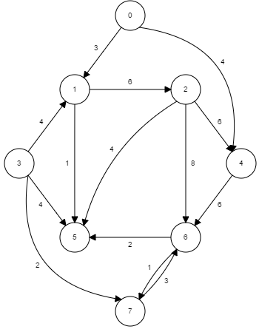
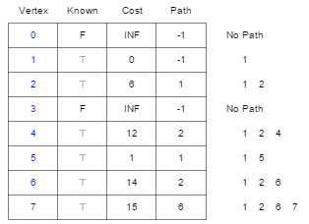
Directed Graph
Start vertex: 1
Path is alternate for parent
Cost is alternate for distance

Slide 44
Dijkstra’s Shortest Path Algorithm
Algorithm: DIJKSTRA(G, start)
Input: Graph G and start vertex of graph G
Steps:
PQ = new PriorityQueue(V) //where V is number of vertices
Mark start’s dist=0
For each node v in G //initialization of all nodes
if start != v
d[v]= infinity
p[v]=null
end if
PQ.add(v,d[v])
End For
while PQ is not empty
u = PQ.removeMin()
For each node v adjacent to u that is in PQ //updating distances of adjacent nodes
if d[v] > d[u]+ cost(u,v) //cost mean edge weight between u and v
d[v] = d[u] + cost(u,v) // update distance with new value
p[v] = u // update prev pointers to maintain path
PQ.decrease_Priority(v,d[v])
End if
End For
End While
return d[] and p[]

Slide 45
Time Complexity?
Depends upon implementation of priority queue
With array/ linked list implementation
removeMin() will take O(V) time
Priority update at each distance update→ O(1) time
With binary heap implementation
removeMin() will take O(logV) time
Priority update at each distance update→ O(logV) time
Time complexity with array or list as priority queue will be O(V²)
Time complexity with heap as priority queue will be O(E+ VlogV)
For details please visit:
http://en.wikipedia.org/wiki/Dijkstra%27s_algorithm
https://www.cs.cornell.edu/courses/cs312/2002sp/lectures/lec20/lec20.htm

Slide 46
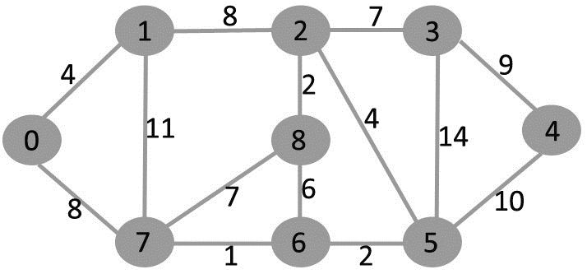
Dijkstra’s Shortest Path Algorithm
Run Dijkstra’s algorithm on following graph, taking 0 as start node.

Slide 47
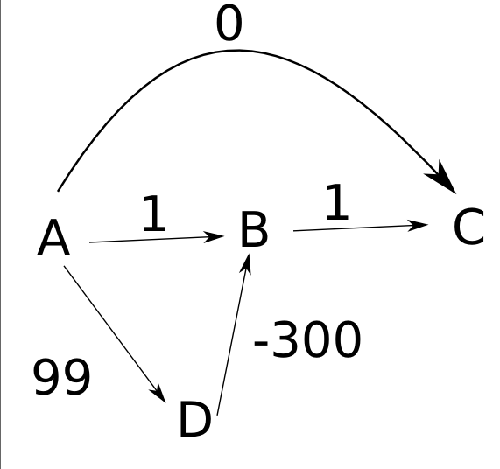
Where Dijkstra’s fails?
Run Dijkstra’s algorithm on following graph taking A as start vertex:
Is there any problem with final answers?
What is shortest path distance from A to B according to Dijkstra’s?
What is actual shortest path distance from A to B

Slide 48
Topological Ordering/Sort
Topological ordering of a directed graph is a linear ordering of its vertices such that for every directed edge (u, v) from vertex u to vertex v, u comes before v in the ordering. Vertices are placed in an ordering according to edges.
Order the vertices from left to right
Very helpful to decide relative ordering of tasks.
Which tasks can be ignored.
Which must be accomplished in order to complete another task
B
D
Source
Sink
A
A
B
C
E
D
Topological Ordering
A B C E D
C
E

Slide 49
Topological Sort/Ordering
Applications:
Scheduling Dependency
Which task should be performed in which order
Which tasks depends upon other to be completed first
Course pre-requisites
Class order in object oriented design
Which tasks are independent
CS19
CS22
CS16
CS141
CS242
CS15
CS17
CS18
CS32
CS123
CS224

Slide 50
Topological Ordering
What is topological ordering?
Any observation?
What is topological ordering?
Any observation?
What is topological ordering?
Any observation?
B
D
B
D
B
A
A
A
C
E
C
E
C

Slide 51
Topological Ordering
What is topological ordering?
Fact 1:
Graph must be acyclic-DAG
You can’t define order in case of cycle
What is topological ordering?
Fact 2:
Multiple topological orderings are possible.
A B C D E
A B C E D
A C B D E
A C B E D
What is topological ordering?
Fact 3:
For any DAG, a topological ordering must exist.
B
D
B
D
B
A
A
A
C
E
C
E
C

Slide 52
Topological Ordering
How to get topological ordering of vertices?
Will DFS help here?
What is the order of vertices according to discovery time?
What is the order of vertices according to finish time?
How to detect Cycle?
B
D
A
C
E

Slide 53
Topological Ordering
Using DFS
Here’s a step-by-step algorithm for topological sorting using Depth First Search (DFS):
Create a graph with n vertices and m-directed edges.
Initialize a stack and a visited array of size n.
For each unvisited vertex in the graph, do the following:
Call the DFS function with the vertex as the parameter.
In the DFS function, mark the vertex as visited and recursively call the DFS function for all unvisited neighbors of the vertex.
Once all the neighbors have been visited, push the vertex onto the stack.
After all, vertices have been visited, pop elements from the stack and append them to the output list until the stack is empty.
The resulting list is the topologically sorted order of the graph.
2/9
4/5
B
D
1/10
A
C
E
3/8
6/7
A
B
C
E
D

Slide 54
DFS Edge Classification
During DFS traversal of a directed graph G, edges can be classified into four different types when explored. This classiﬁcation of edge (u, v), depends on whether we have visited v before u in the DFS and if so, the relationship between u and v.
If there is an edge from u to v then edge (u, v) can be classified as:
Tree edge: if (u,v) is present in dfs tree→ p[v]=u
If V has already been visited from some other vertex
Backward edge: if v is ancestor of u in dfs tree
Forward edge: if v is descendent of u in dfs tree
Cross edge: v is neither ancestor nor the descendent in dfs tree
This classification is very helpful to solve certain problems
Cycle detection

Slide 55
DFS Edge Classification
Graph and its DFS tree
If a graph has a back edge, it contains a cycle.
1/10
Forward-edge
B
D
Tree-edge
B
D
A
3/8
2/9
Cross-edge
A
Backward-edge
C
E
C
E
6/7
4/5

Slide 56
DFS Edge Classification
How to detect if an edge is back edge?
See the following graphs, which one contains a back edge
Is there any specific observation?
Edge type and vertex color?
1/
B
1/
B
1/
1/
A
A
B
D
B
D
3/
2/
3/4
2/5
3/8
2/
3/
C
C
A
A
2/
C
E
C
6/
4/5
4/

Slide 57
DFS Edge Classification
How to detect back edge?
If an edge is going back to a grey vertex
It’s a back edge.

